Slide 1
Classic Ethernet

Slide 2
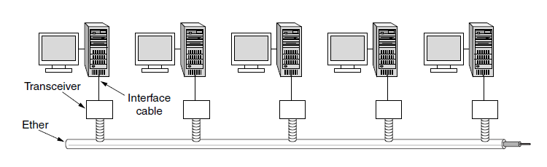
Classic Ethernet Physical Layer
Shared coaxial cable with all hosts attached
Up to 10Mbps

Slide 3
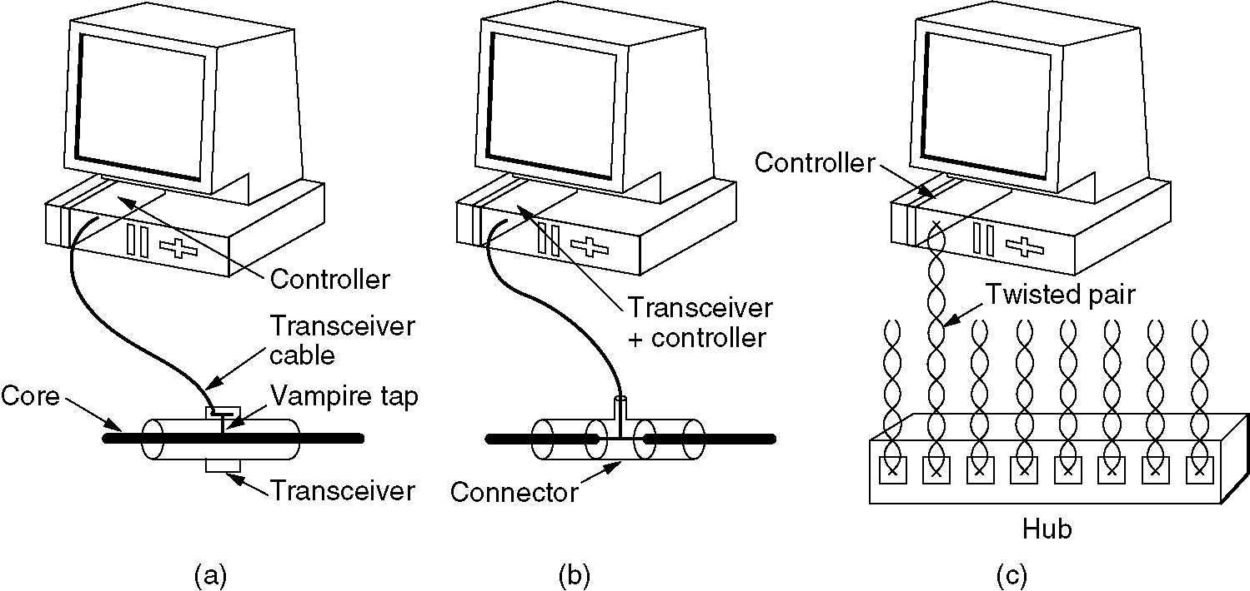
Ethernet Cabling
Three kinds of Ethernet cabling.
(a) 10Base5, (b) 10Base2, (c) 10Base-T.

Slide 4
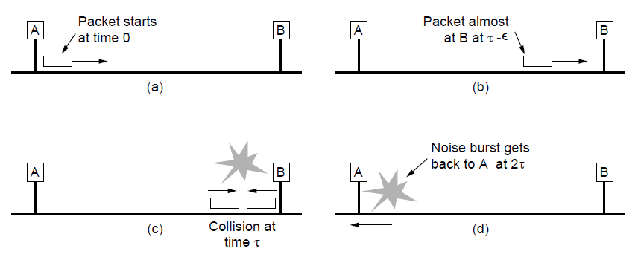
Collision Detection (CD)
Collision detection can take as long as 2τ.
Max cable length of relevance

Slide 5
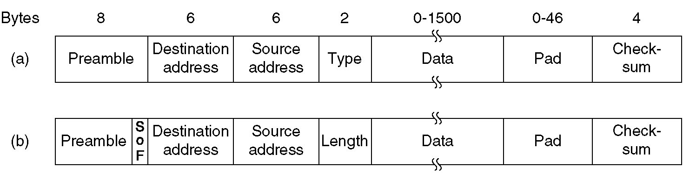
Ethernet MAC Sublayer Protocol
Frame formats. (a) DIX Ethernet, (b) IEEE 802.3.
Addresses: MAC addresses Manufacturer-provided unique number per Ethernet card (6-bytes, e.g. 8c:85:90:07:d9:db)

Slide 6
Length/Type
If Length/Type is type, then where is the length?!
Ethernet length was determined by looking inside the data – a layer violation.
802.3 added another header for the Logical Link Control (LLC) protocol within the data. It uses 8 bytes to convey the 2 bytes of protocol type information.
Rule of thumb: Any number greater than 0x600 (hex / base16) can be interpreted a Type, otherwise the field is interpreted as Length.

